Slide 1

Cashback Calculator App
CS 641: Mobile Web Content Development – Fall 2023 71435
Group 2
Presented:
Yakshita Rakholiya, Brittany Benjamin, Bansari Sorathiya, Krushil Sheladiya, Filippo Zallocco, Ritika Chougala, Pankti Desai, Jinit Desai

Slide 2
TABLE OF CONTENTS
Introduction
Project Overview
Project Architecture
Demo
Frontend Screens Overview
Authentication (Firebase Auth)
Backend - Firebase Realtime Database
Backend - Firestore Database
Conclusion

Slide 3
Introduction
Project Introduction: The Cashback Calculator App is a React Native application integrated with Firebase services, enabling users to calculate rewards based on their spending and manage card information efficiently.
Technologies Used:
React Native
Firebase
Problem Statement: Users need a tool to calculate rewards based on spending and efficiently manage their card details in one place.
Objectives and Goals:
Develop a user-friendly app for cashback calculation
Implement secure and reliable card information storage

Slide 4
Project Architecture
Frontend: React Native
Login/Signup Screens: Authenticate users through Firebase Authentication for secure access.
Wallet Screen: Displays stored card information with Realtime Database integration.
Add Cards Screen: Allows users to add new cards, linking to Realtime Database for card storage.
Card Details Screen: Provides detailed card information, integrated with Realtime Database.
Rewards Calculation Screen: Calculates rewards based on user inputs using Firestore for secure data storage.
Category Screen: Displays and analyzes various categories related to card rewards.
Profile Screen: Displays user information, integrated with Firebase Authentication for login/logout.
Backend: Firebase
Authentication: Utilizes Firebase Authentication for secure user login/logout functionality.
Realtime Database (for cards): Stores and retrieves card details in real-time for efficient card management.
Firestore (for user data): Manages user-related data securely and facilitates scalable data querying.

Slide 5
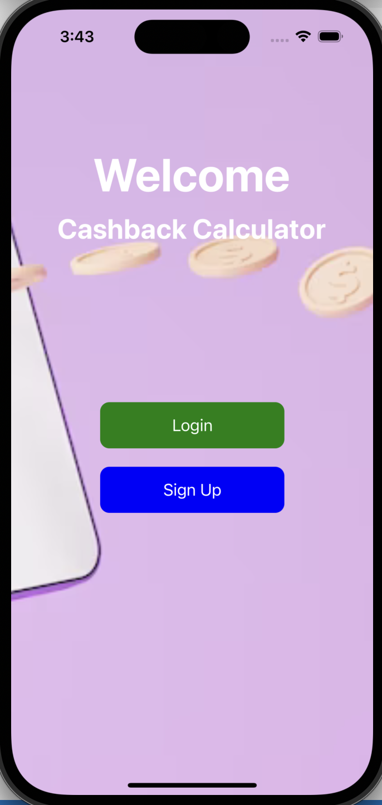
Demo

Slide 6
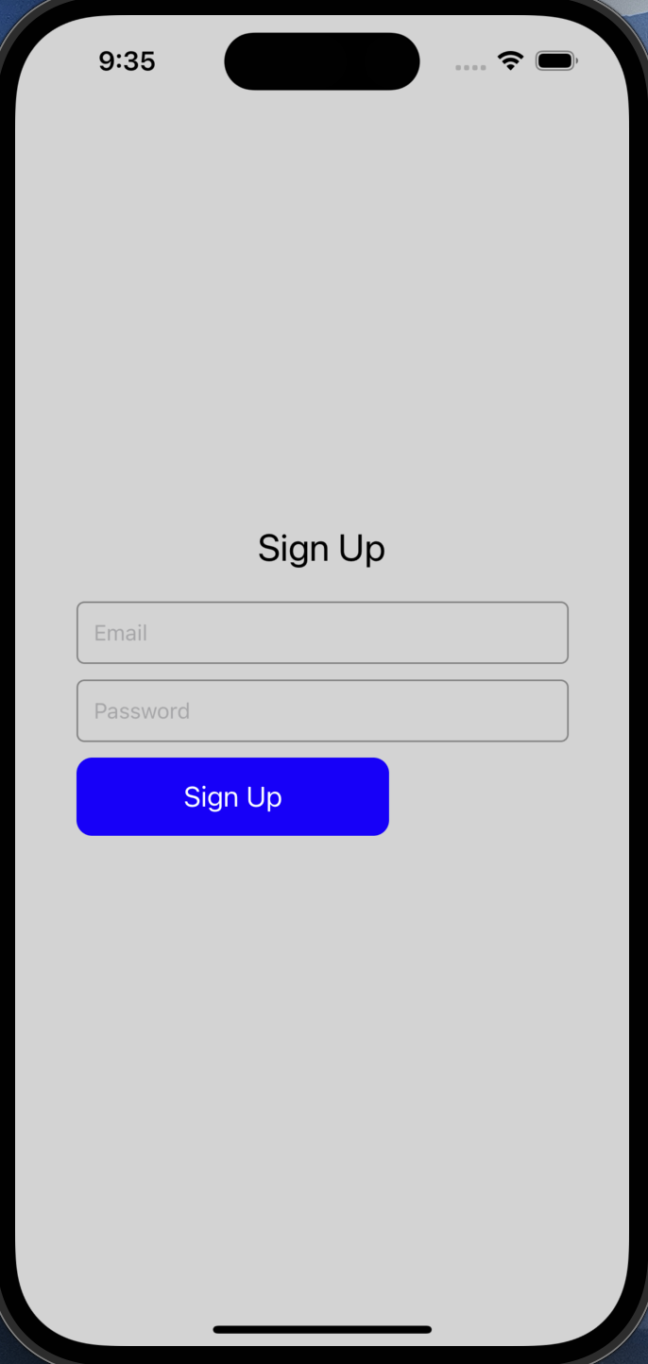
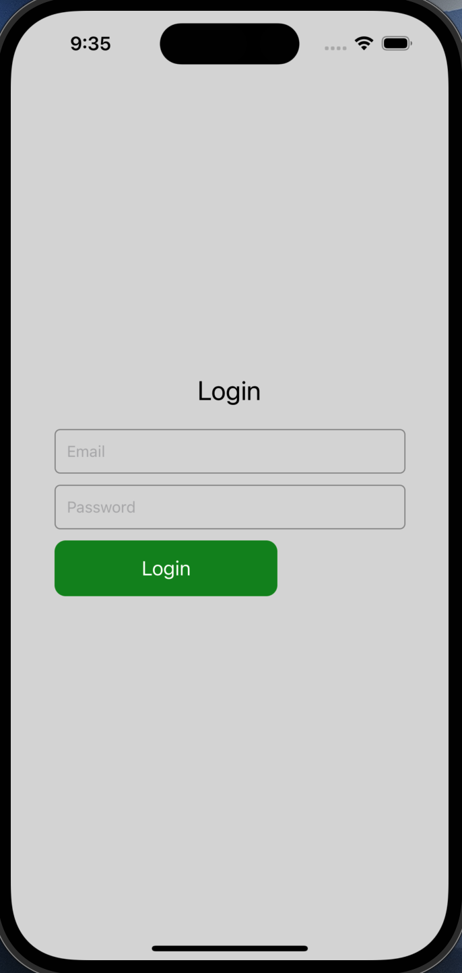
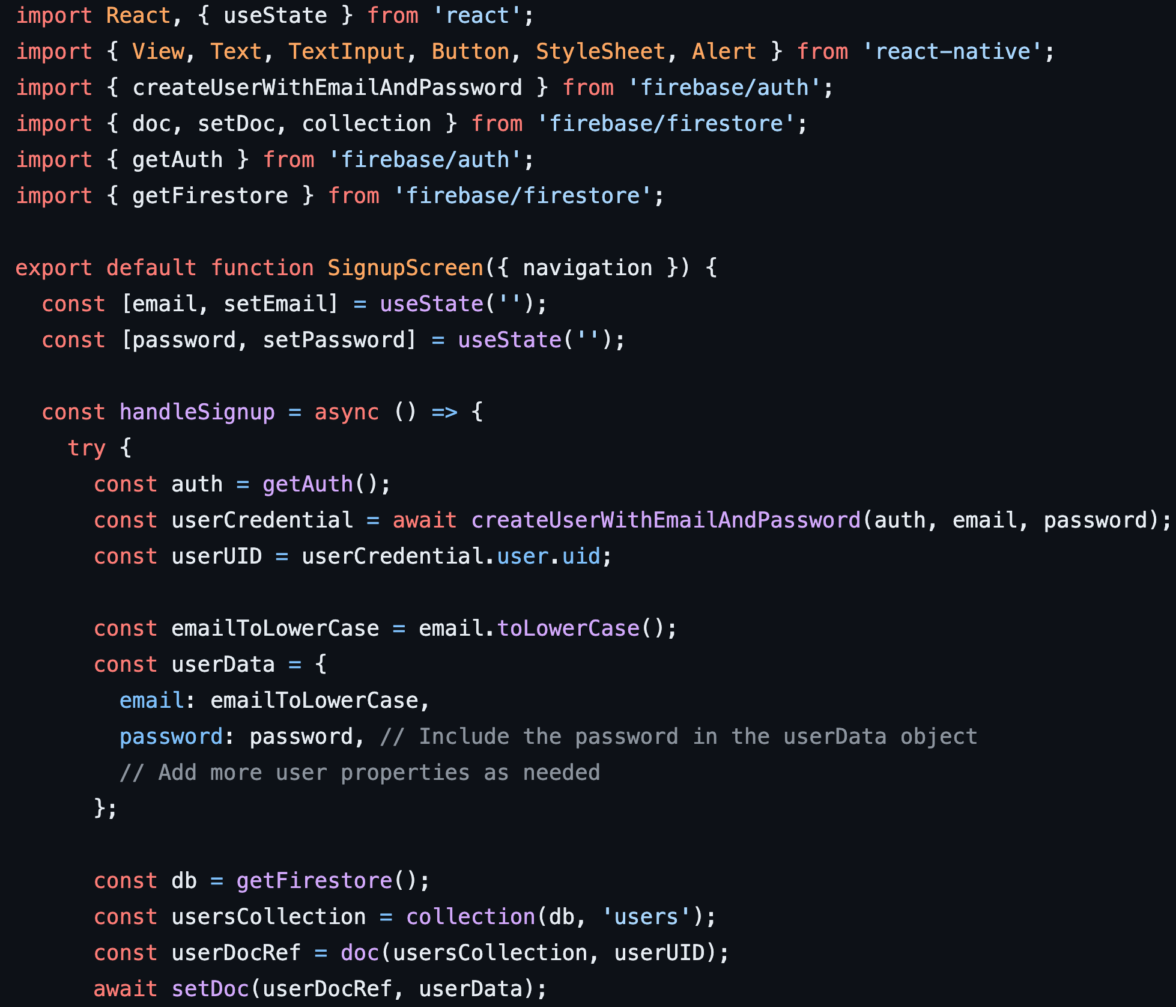
Login/Signup Screens

Slide 7
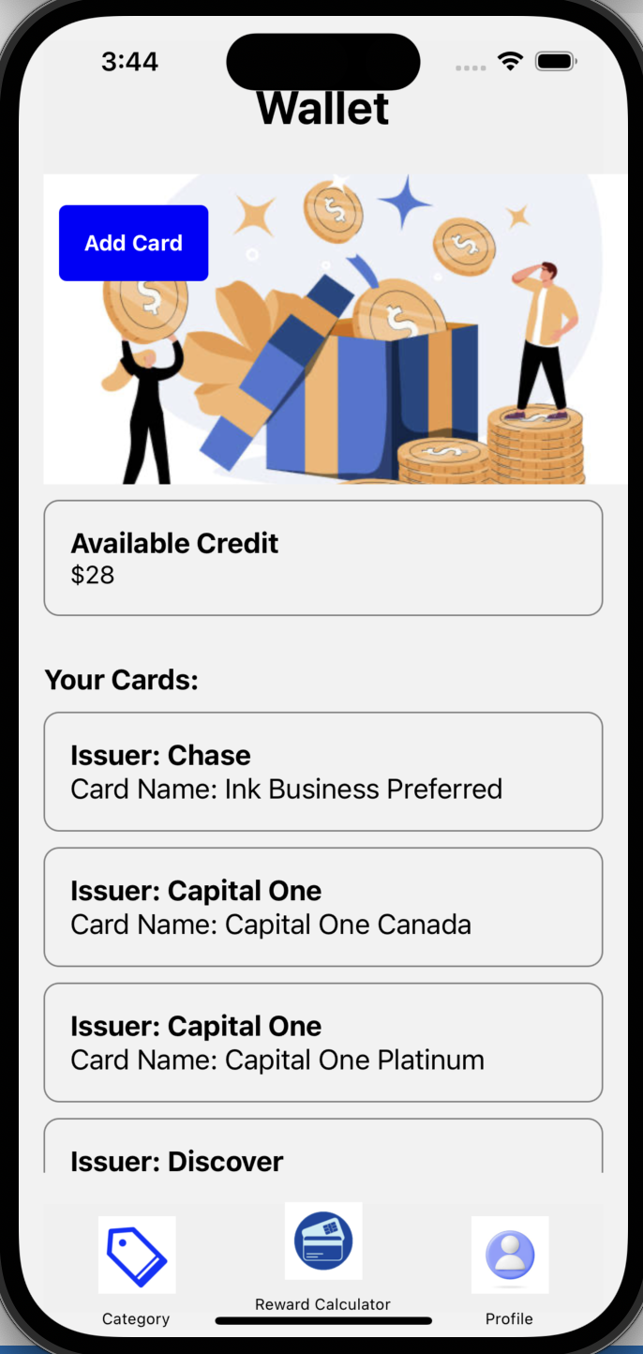
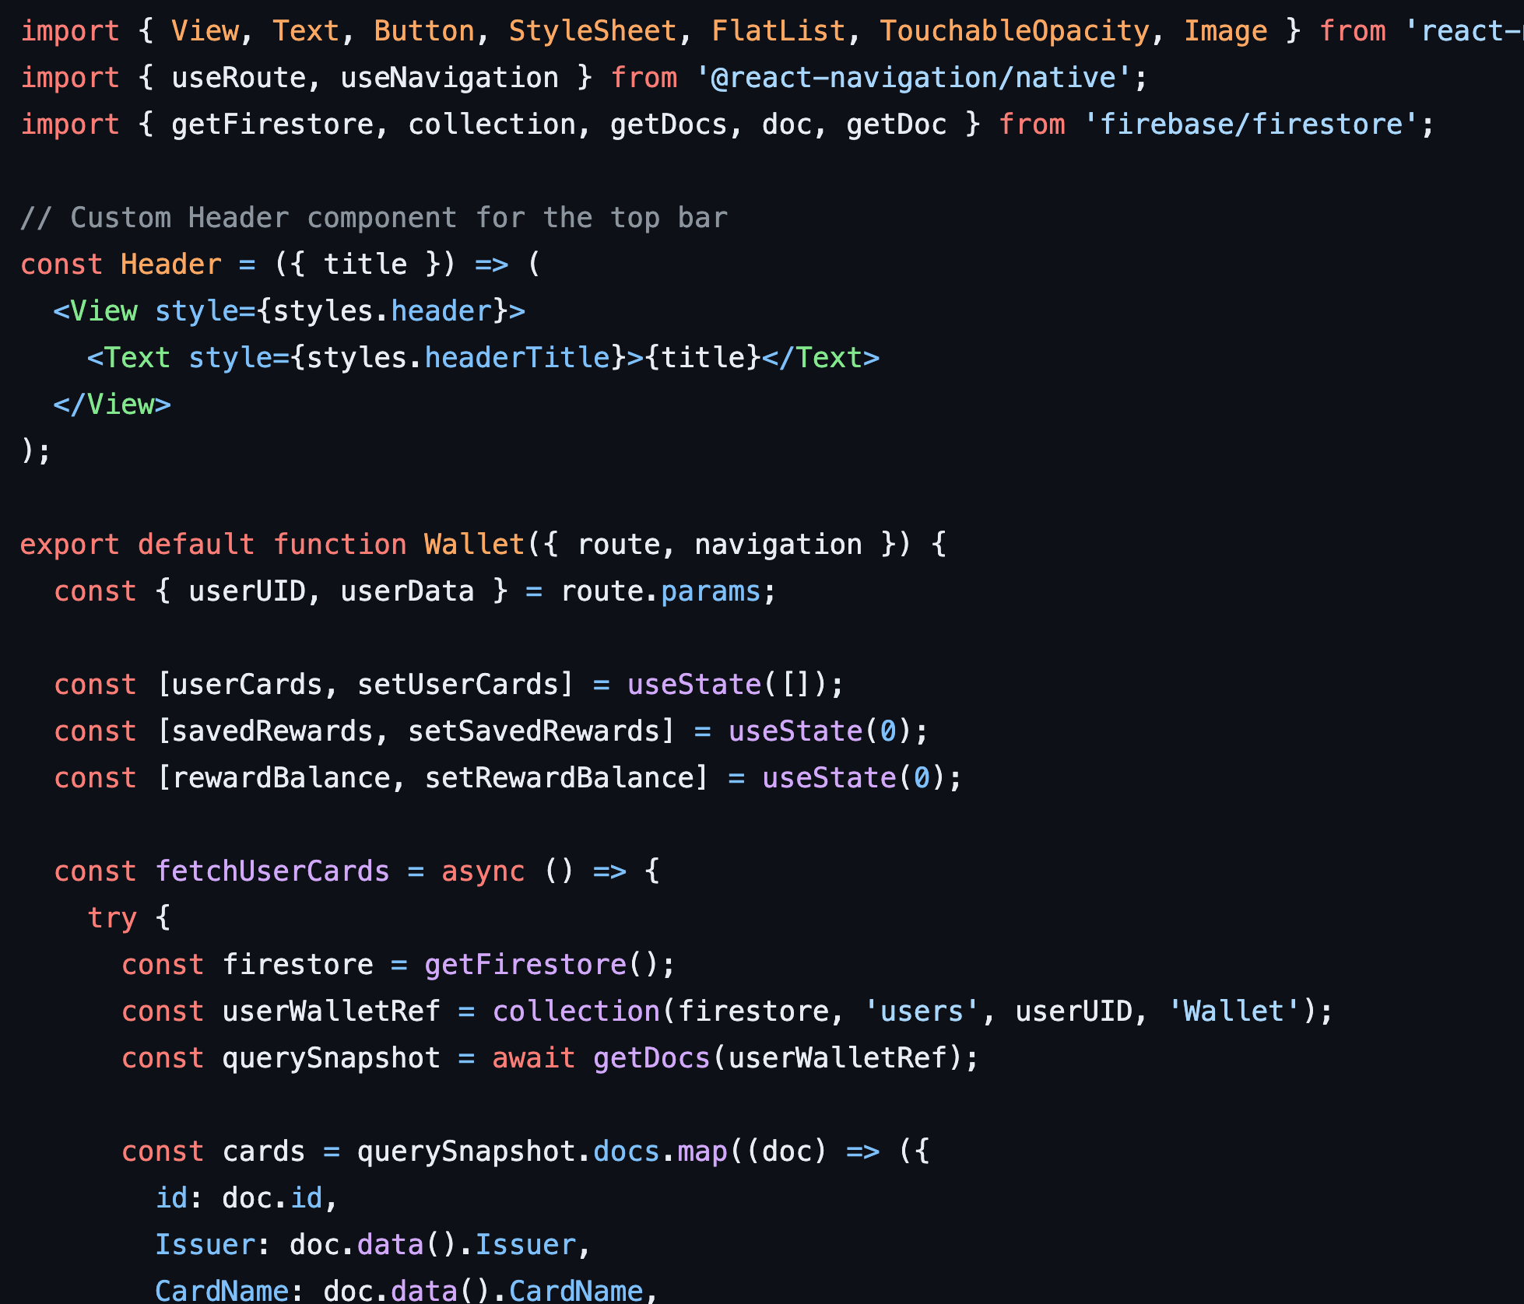
Wallet Screen

Slide 8
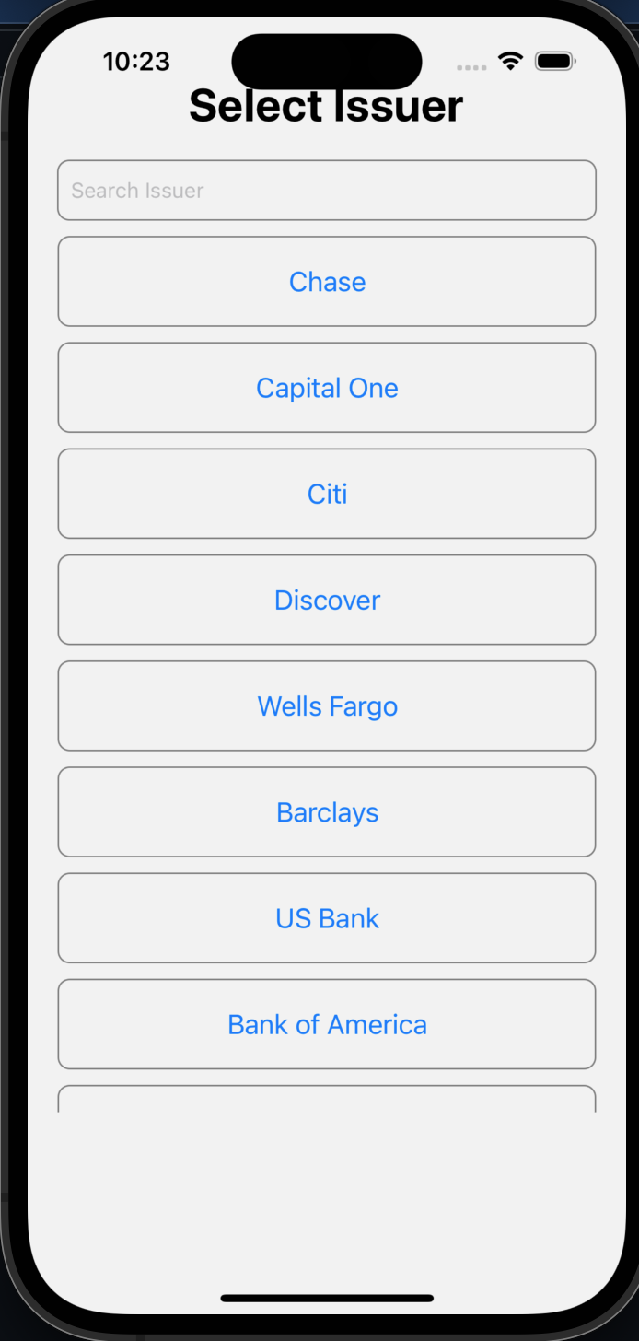
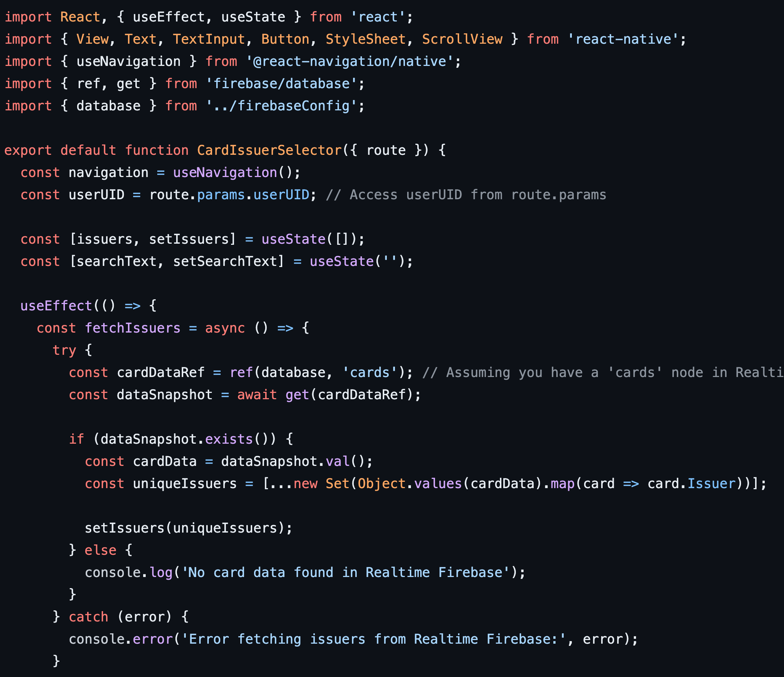
Issuer Screen

Slide 9
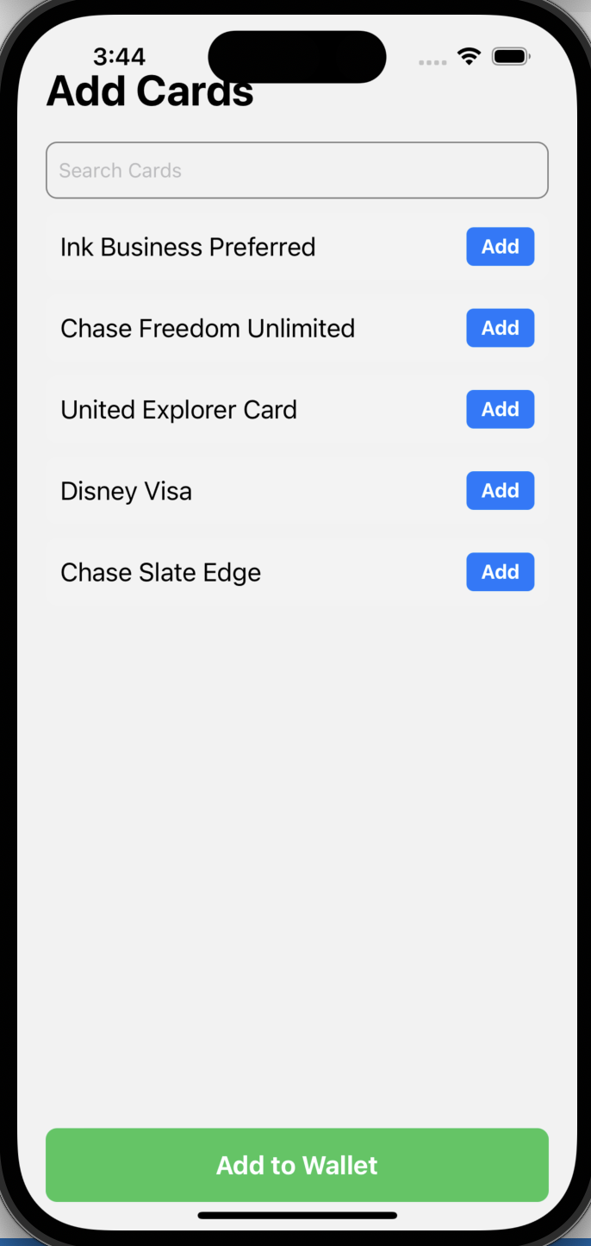
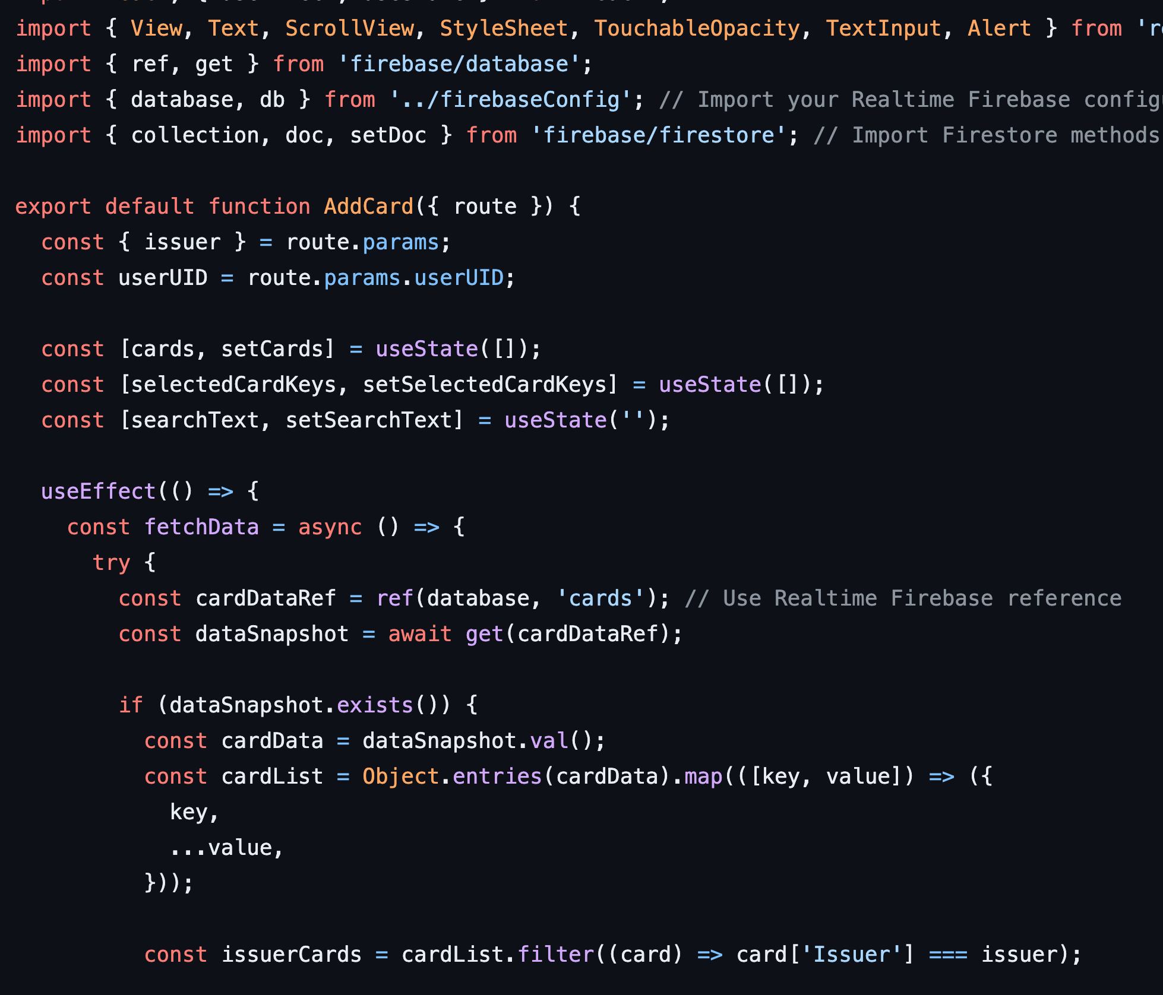
Add Cards Screen

Slide 10
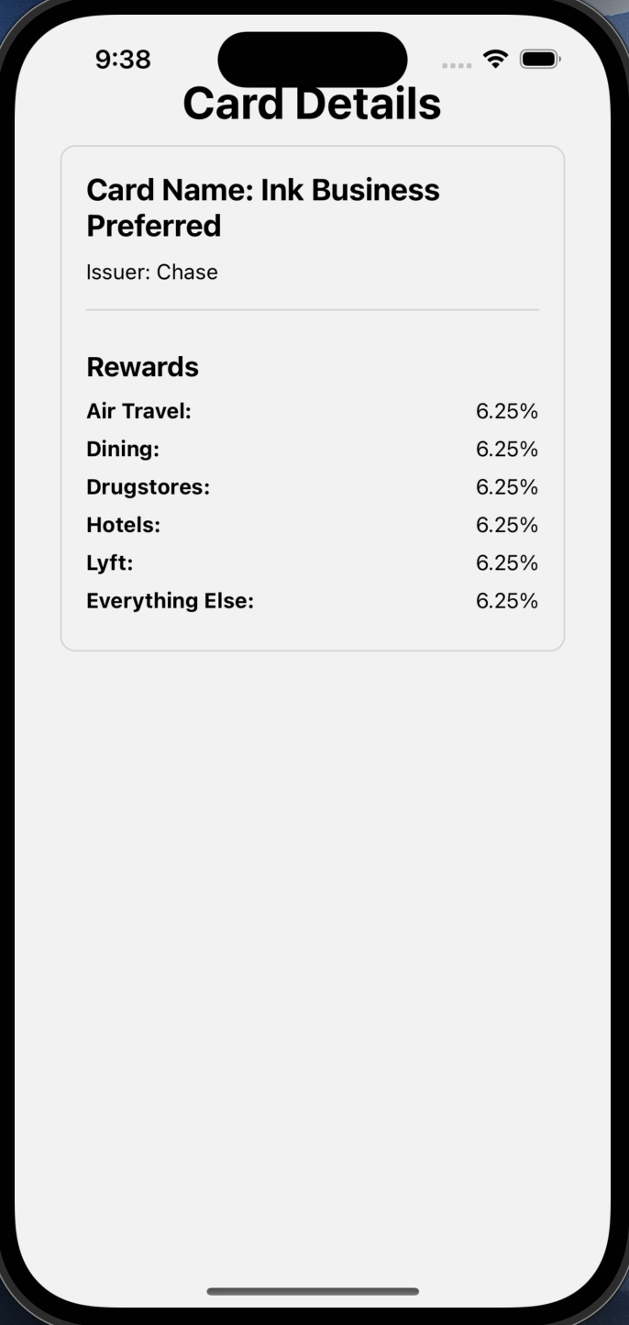
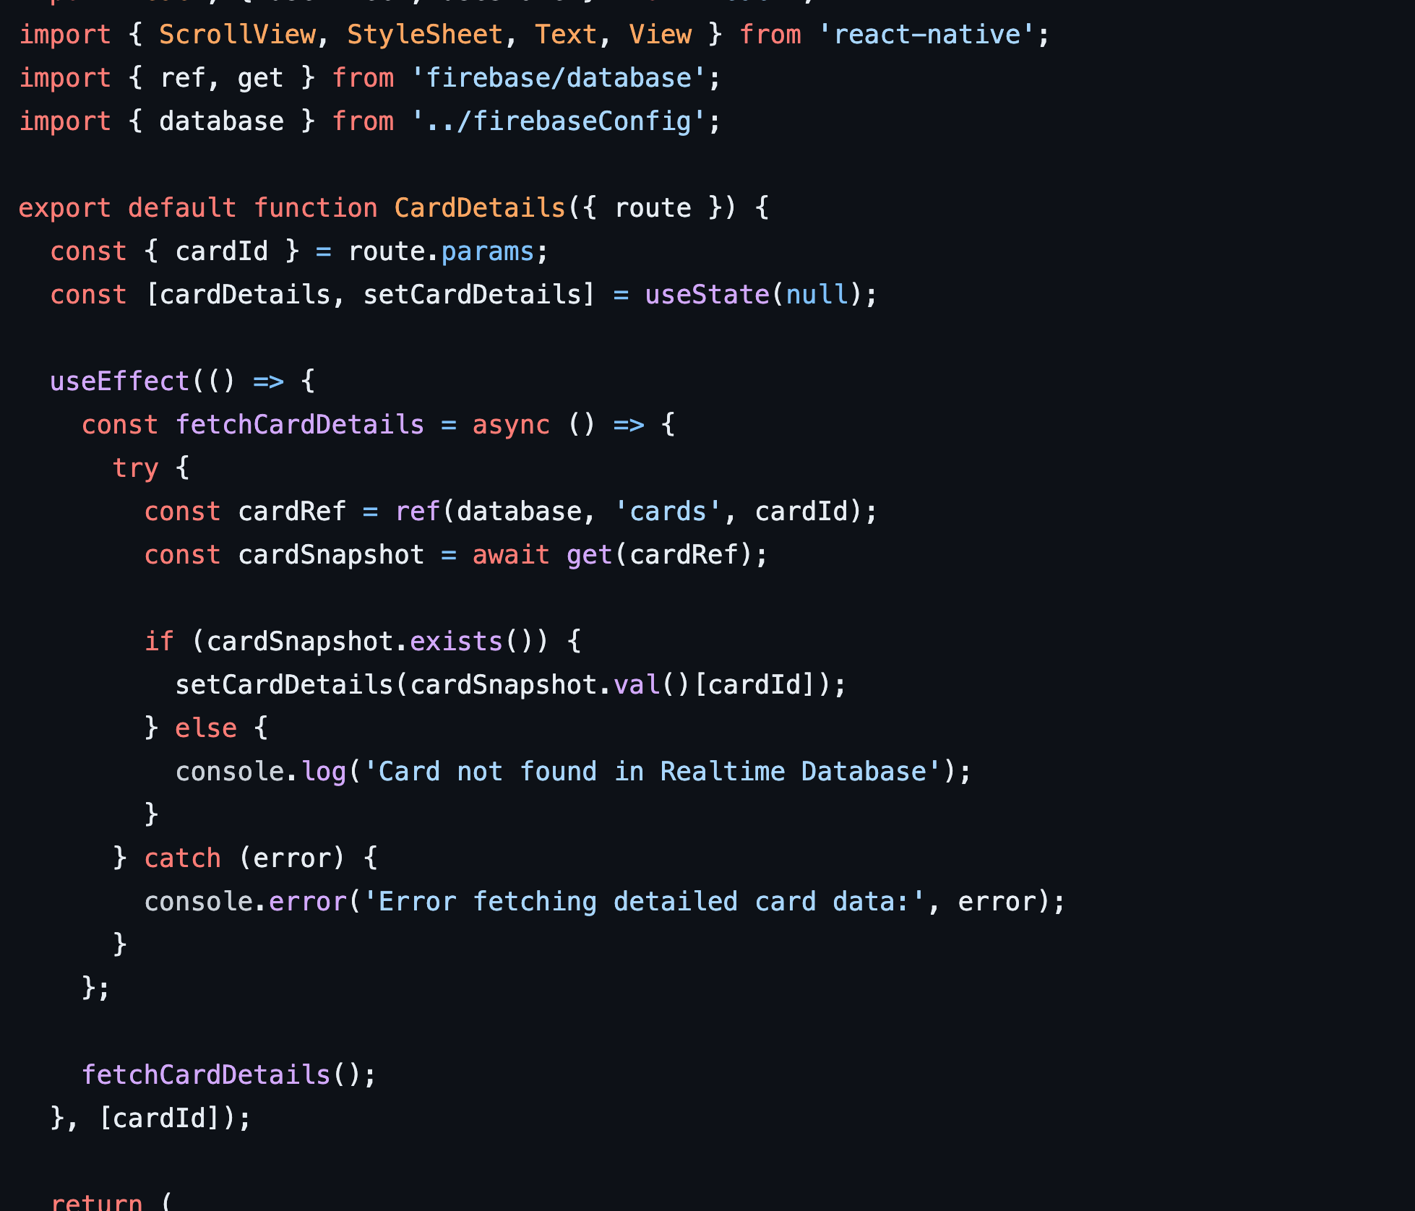
Card Details Screen

Slide 11
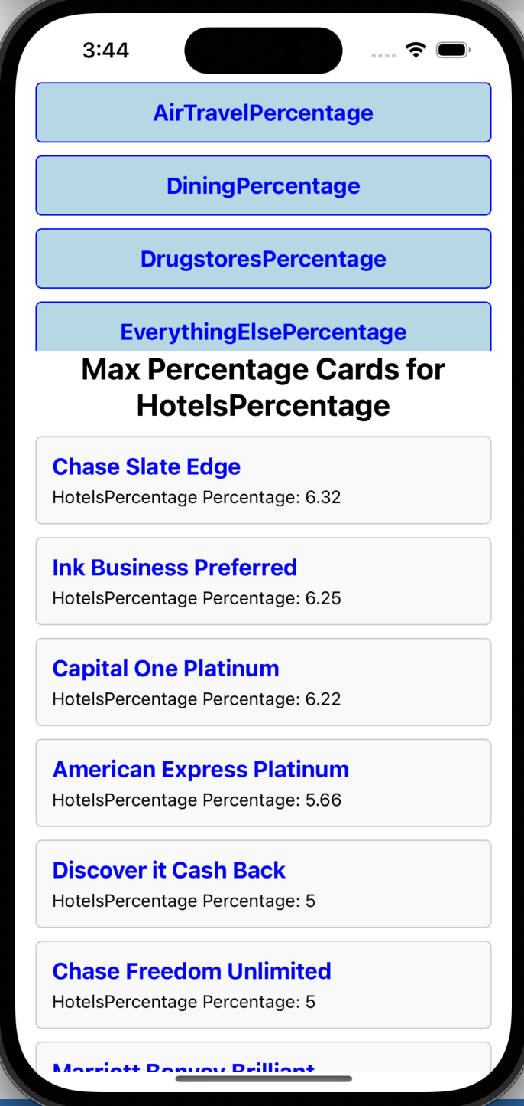
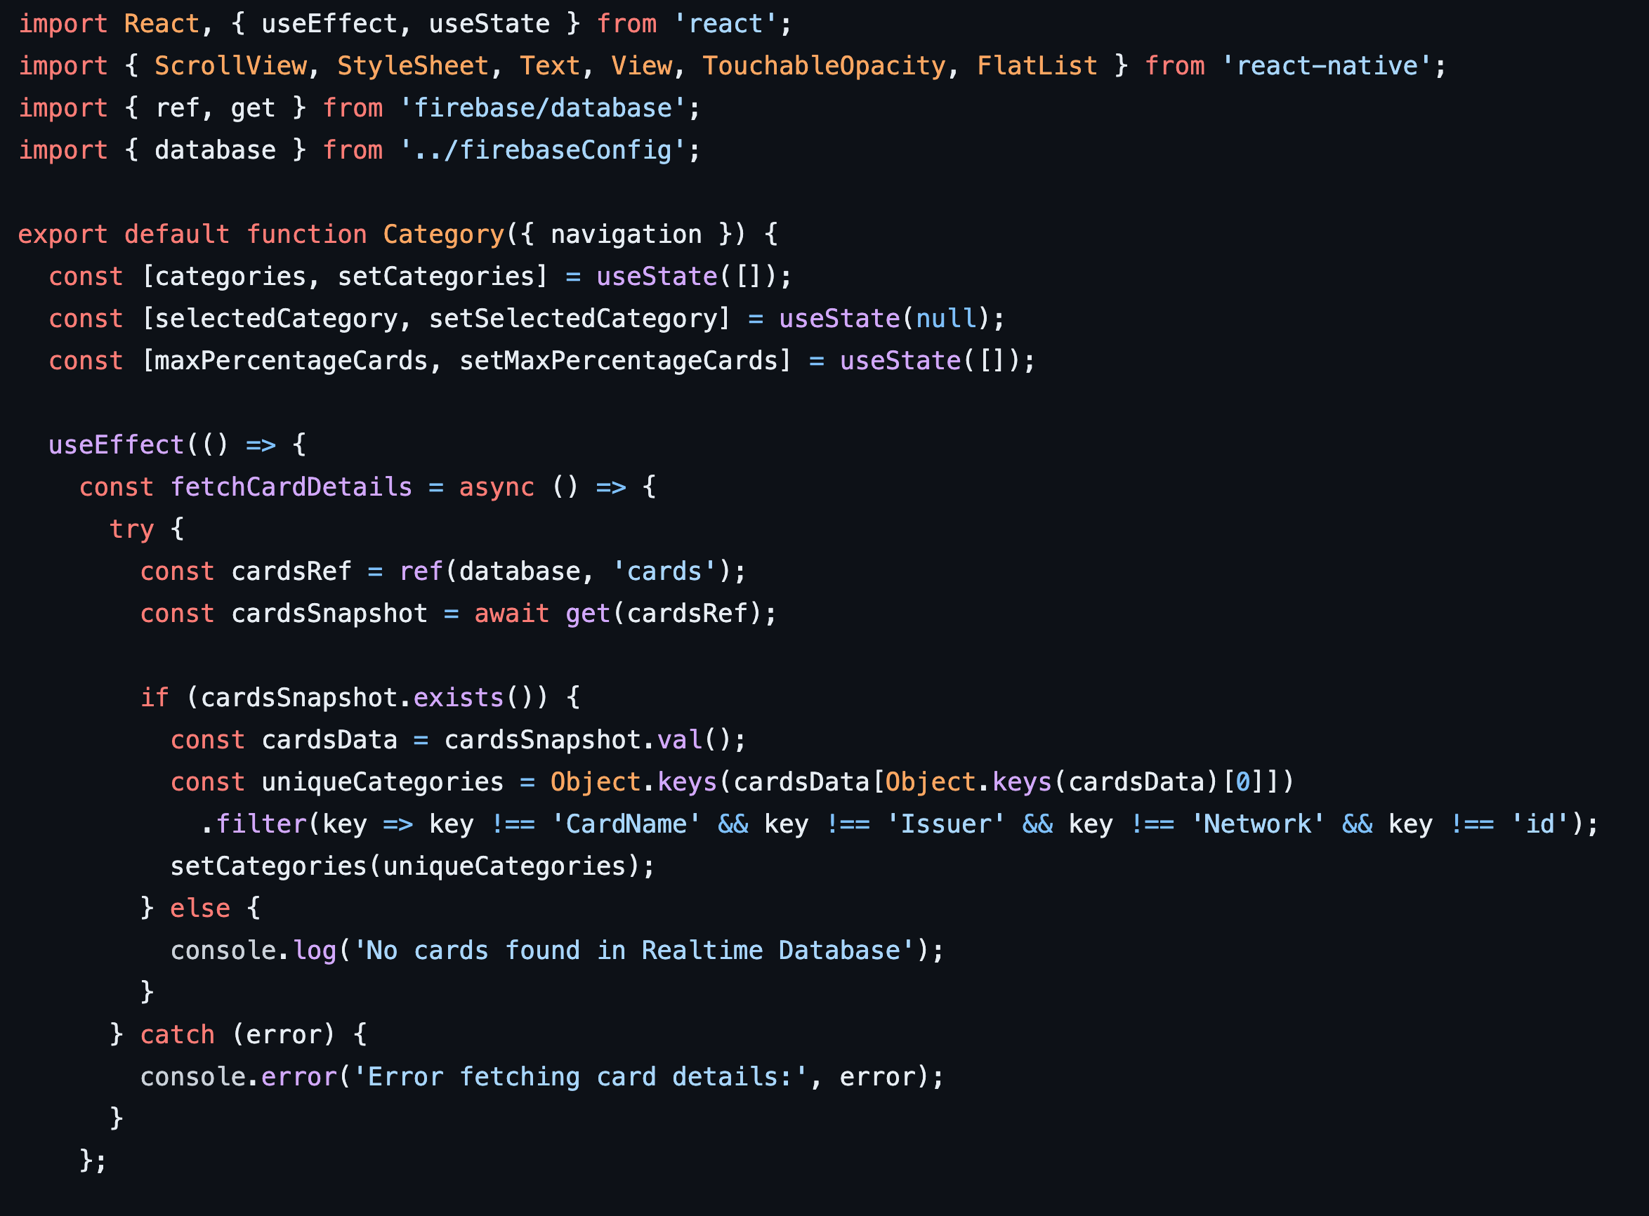
Category Screen

Slide 12
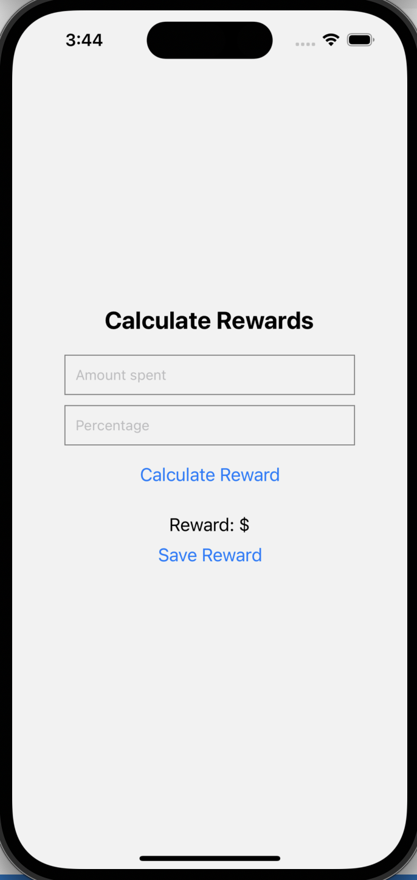
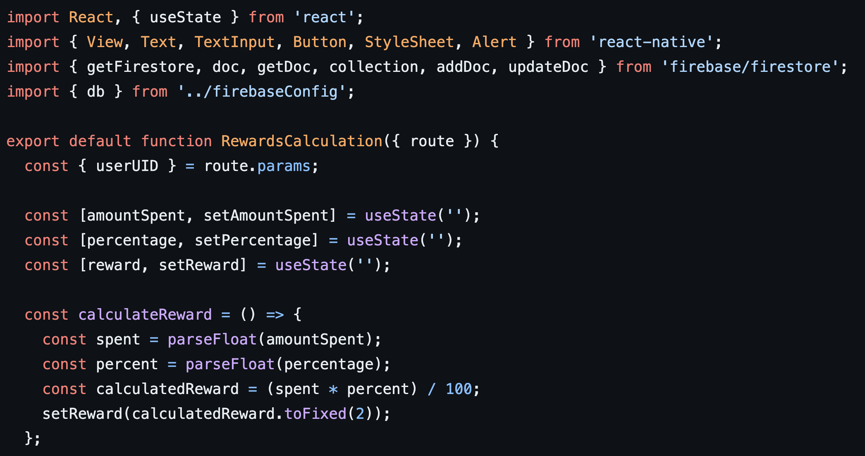
Rewards Calculation Screen

Slide 13
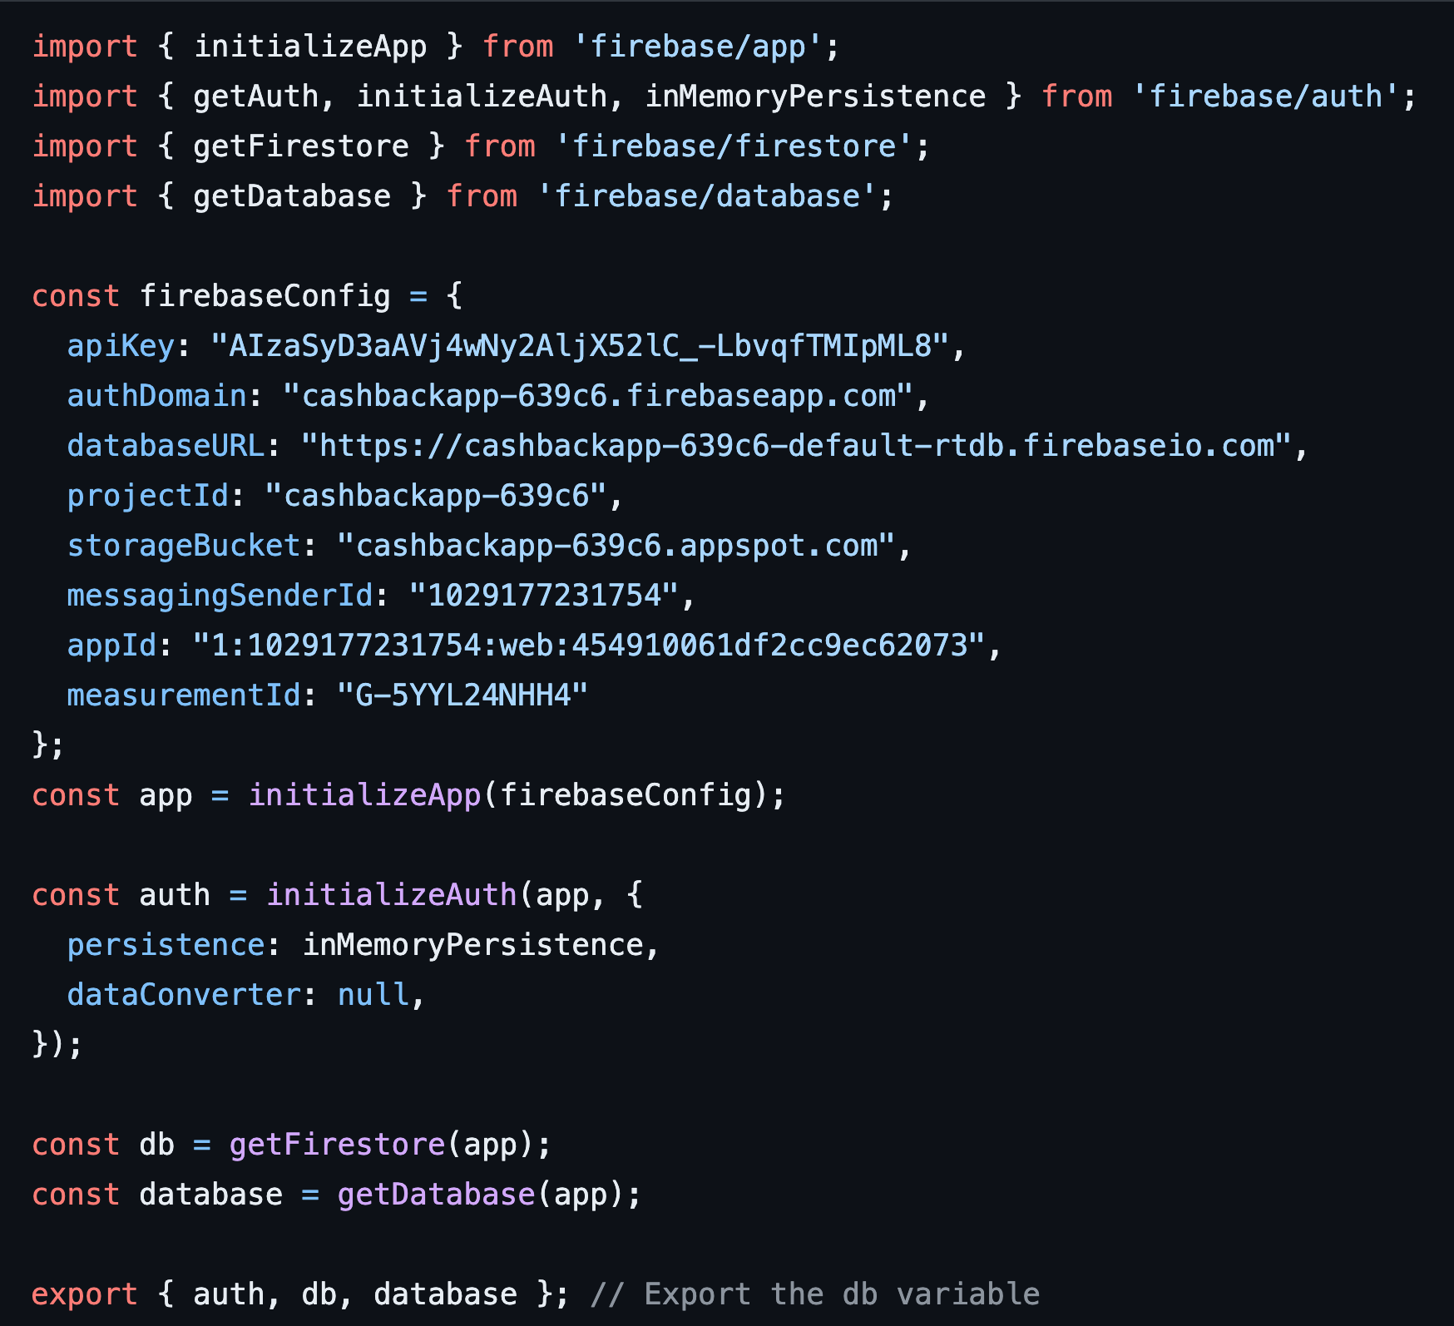
Authentication

Slide 14
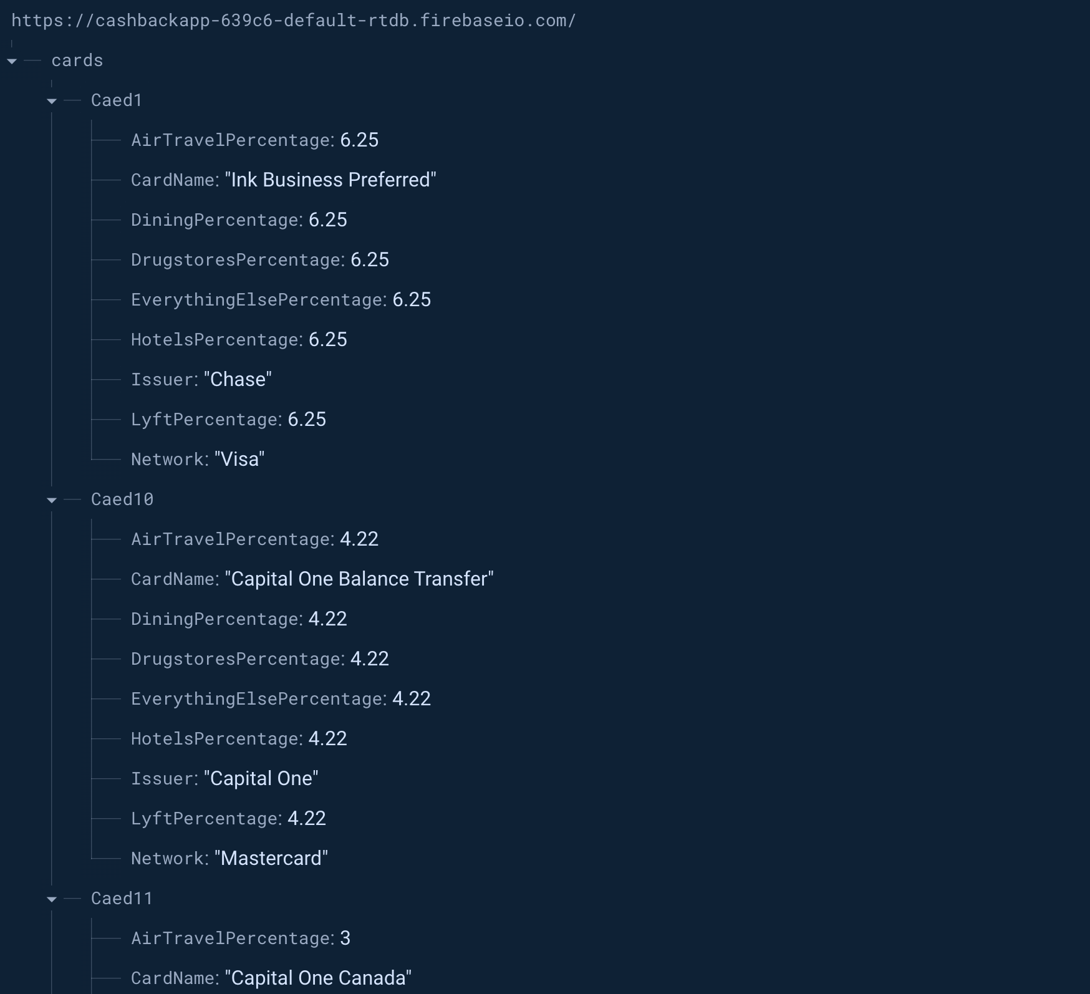
Realtime Database (for cards)

Slide 15
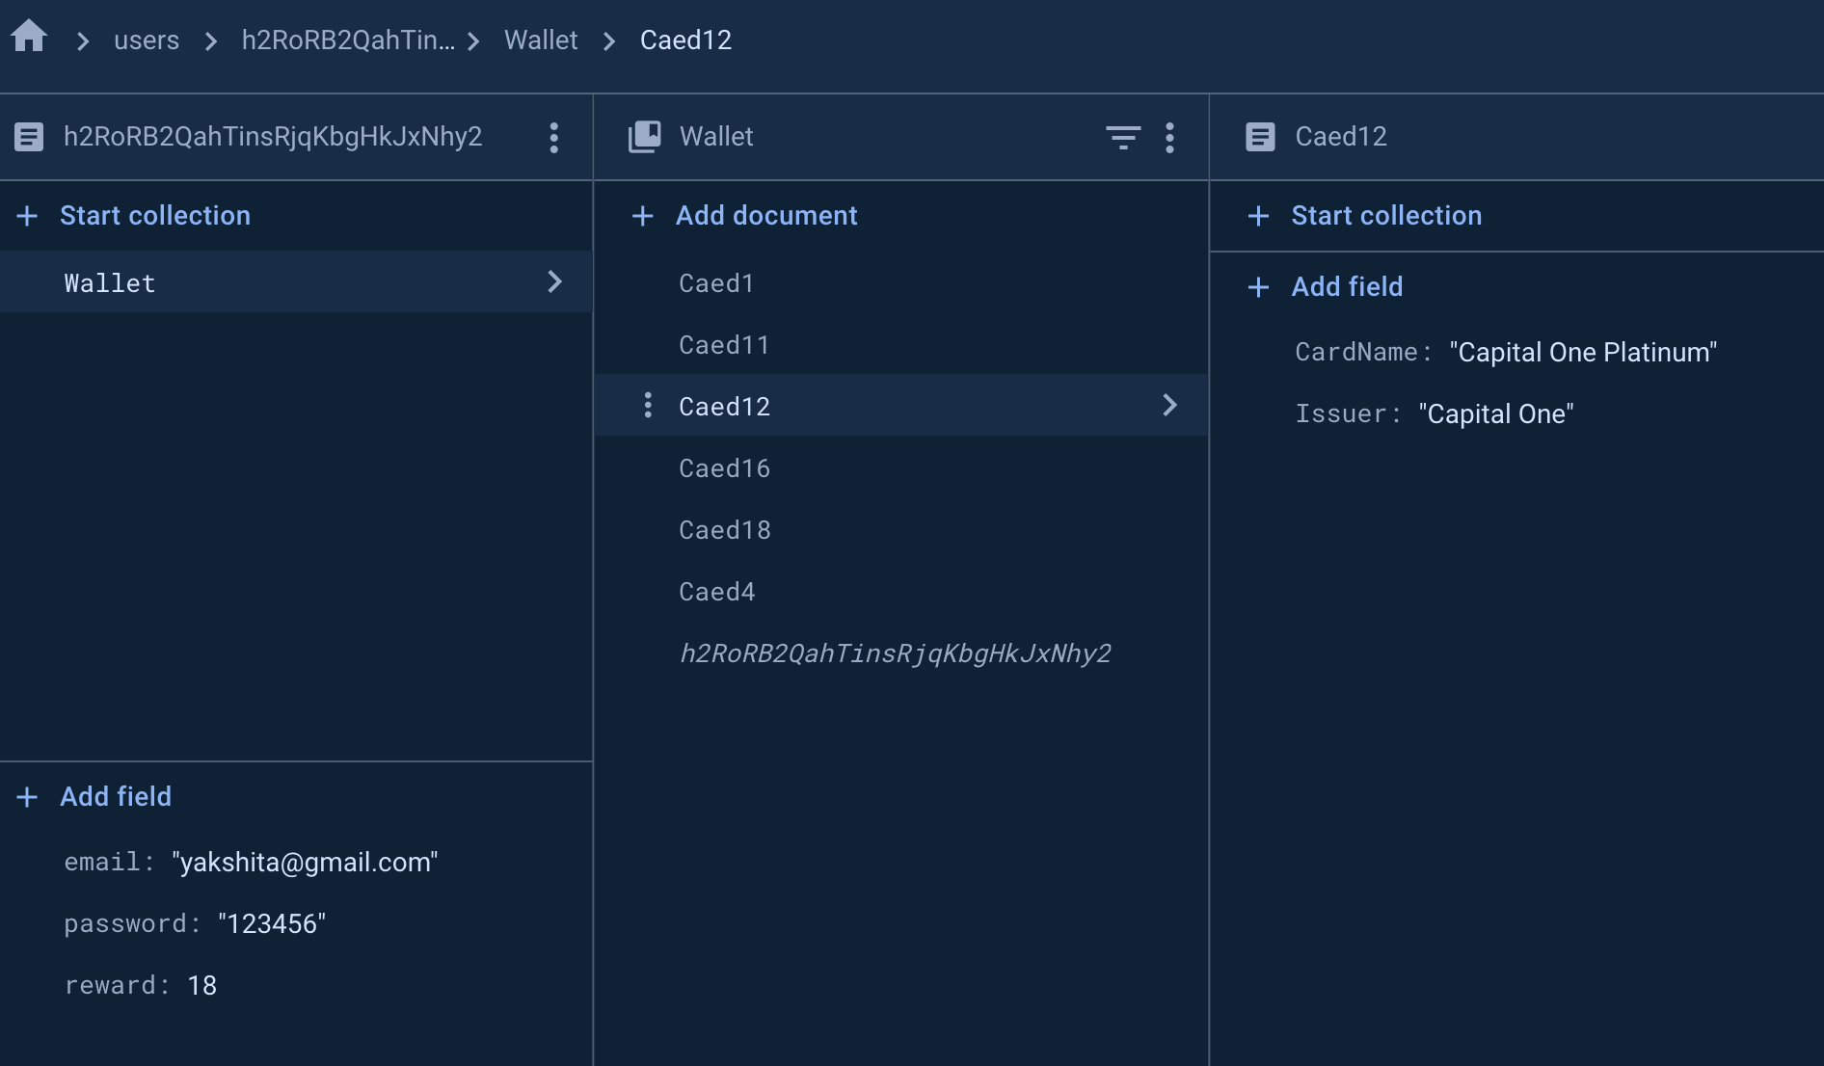
Firestore (for user data)

Slide 16
Conclusion
Summary:
Developed an efficient cashback calculator app
Integrated Firebase for robust backend functionality
Lessons Learned:
Importance of secure user authentication
Real-time database benefits in app responsiveness

Slide 17

Thank You

